Slide 1
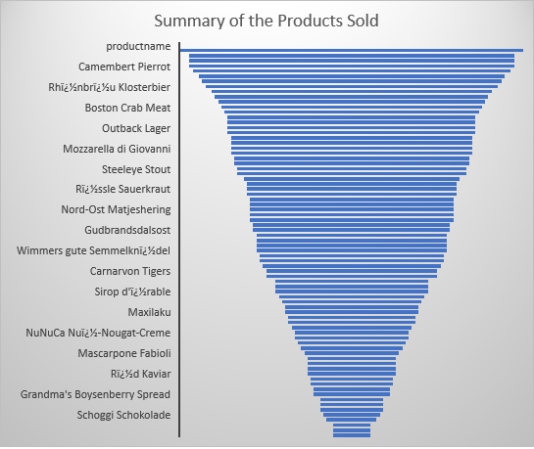
1) Which Product has been ordered most by the customers?
This funnel chart is showing the number of products sold in the order from most sold to least. Basically identifying it will help the company to improve or market better those products which are most wanted by the customers. And also help company to develop some strategy to understand and improve less sold products.

Slide 2
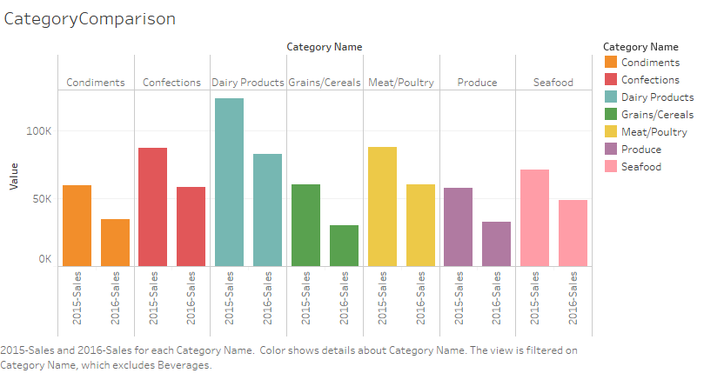
2) For the year 2015 and 2016, what’s the total sales for all the product categories?
This chart is showing categorywise sales of all the products for the year 2015 and 2016. This kind of comparison is required to study about change in customers buying pattern.

Slide 3
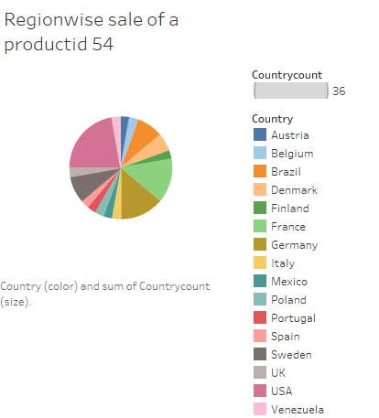
3) Country wise sales distribution for the most sold product id 54?
Pie chart is showing the sales distribution of the top most sold product based on region. USA market is the biggest for this product. Marketing will help develop USA market further.
Country
Austria 1
Belgium 1
Brazil 3
Denmark 2
Finland 1
France 5
Germany 5
Italy 1
Mexico 1
Poland 1
Portugal 1
Spain 1
Sweden 3
UK 1
USA 8
Venezuela 1

Slide 4
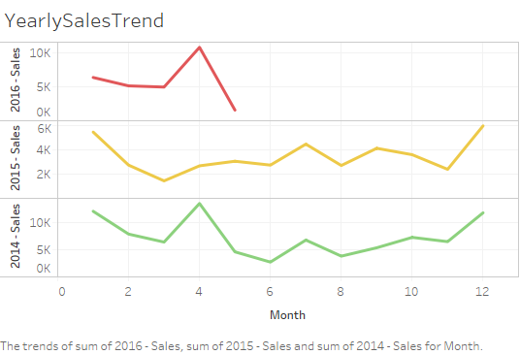
4) How is the sales trend of all the products of the year 2014, 2015., 2016?
This chart is line chart which shows monthly overall sales trend for the year 2014, 2015 and 2016. Since 2014 and 2015 are having similar sales trend we can expect such similar trend for the year 2016 also. 4th and 12th month are showing better sales compare to other months. Its required to know why do we get more orders on those particular months and is there any way to add more products on those months. Also forecast will help to maintain warehouse to serve customers better.

